Slide 1
Building Beyond Buzzwords
“What do you need to develop, build and operate real AI features in production?”
Dr. Andrew Bolster;
Sr. Mgr. (Data Science)
NIDC; 23rd Nov 2024

Slide 3

Who is this for?
People who have started their Data Science journey and having trouble getting traction/impact
People (trying to) support Data Sciencecolleagues
Grumpy old buggers who are tired of people assuming that this stuff is a) new, or b)magic

Slide 4
Agenda
About Me
History of AI, ML, and LLMs
Decision Support Systems
What does it mean to be ‘Production Ready’?
Barriers between Proof-of-Concept and Production
Building Systems, not Features, for Production

Slide 5

About Me
Confessions of a perpetual imposter

Slide 6

Today
Sr. R&D Manager – Black Duck Software
Treasurer – BSides Belfast
Cmtt. Member – NIOpenGov. Network
Cmtt. Member – InfosecNI
Recovering Academic
Ask me anything about Python, ML, NI Tech Ecosystem, Electronics, Hacking, Lockpicking, or running conferences

Slide 7
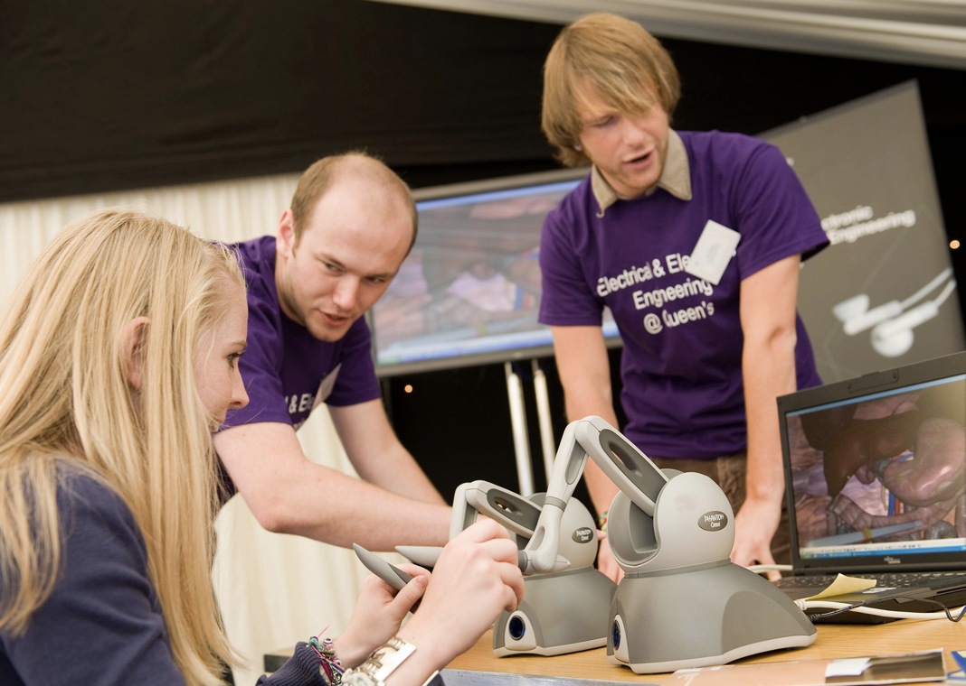
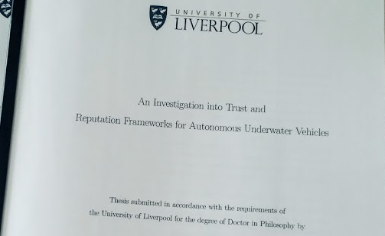
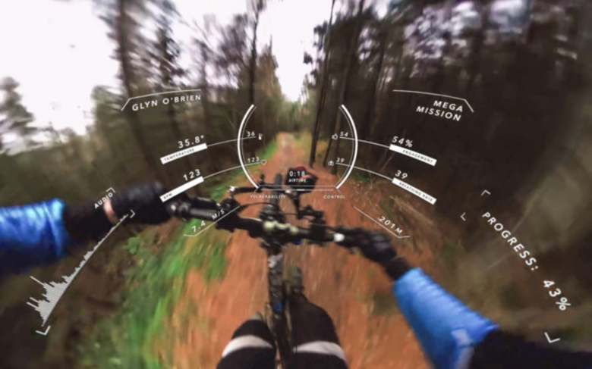
Development Path (1)
More “Careening” than “Careering”
MEng Software & Electronic Systems Engineering (2006)
HPC / Digital Communications / GPU Programming
PhD Electrical and Electronic Engineering (2011)
“An Investigation into Trust & Reputation Frameworks for Collaborative Teams of Autonomous Underwater Vehicles”
Autonomous Warfare Analyst – DSTL/NATO
Ask me about downed Sentinel drones in Iran
Research Engineer/Product Manager – Wi-Fi Security Startup
“Data Scientist” – Bioinformatics Startup (2016)
Everything from real time cloud scale analytics to fixing the WiFi
Developed Emotional Intelligent VR experiences
Threw people down mountains to do it.

Slide 8

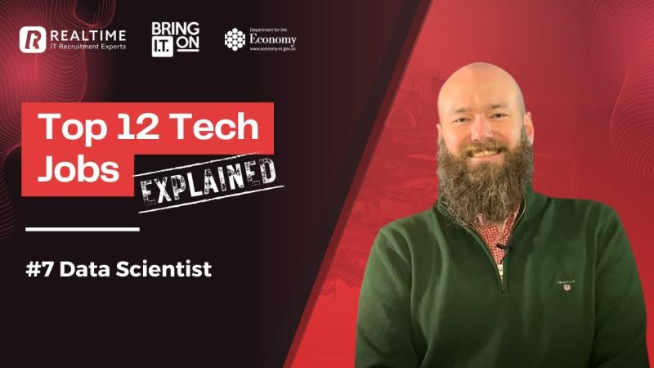
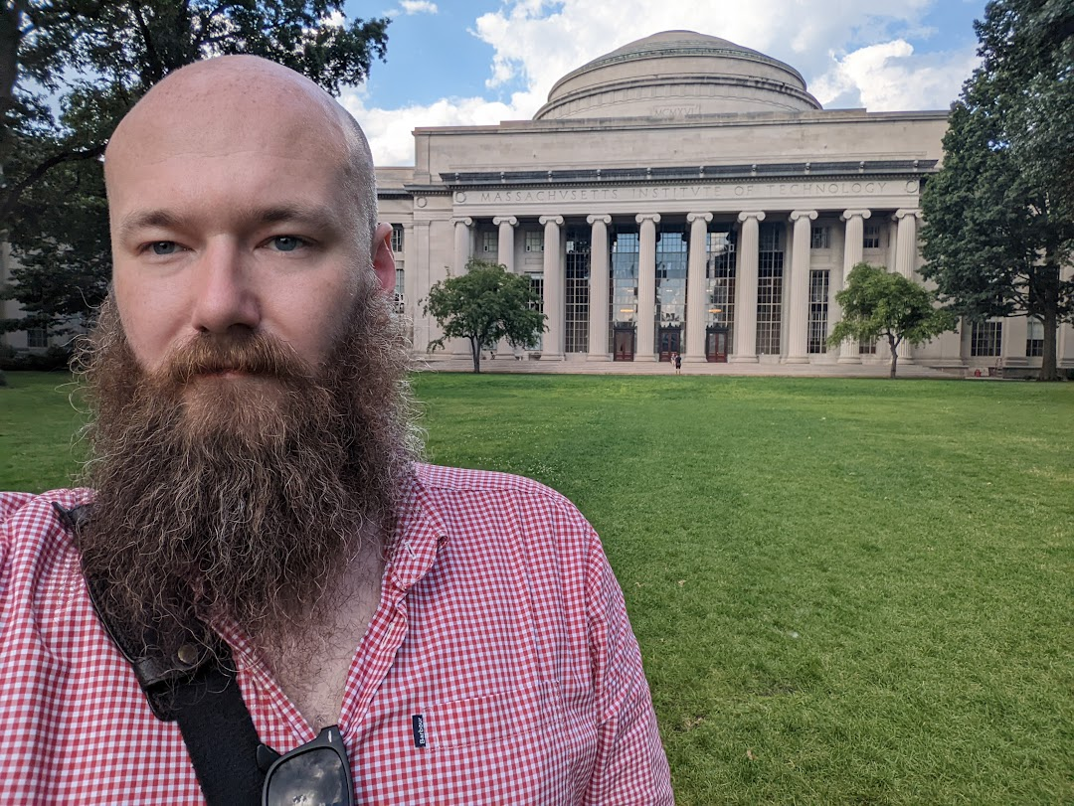
Development Path (2)
More “Careening” than “Careering”
Data Scientist – Cyber Security Industry (2018)
Real Time Network Intrusion Detection System
Multi-terabytes per day of network traffic
Using bio-inspired algorithms to predict hacking/botnets
Mostly making pretty graphs and leaking customer data.
Head of Data Science – Black Duck (2019)
Initially hired as Team Lead (2019, WhiteHat Security)
Then Engineering Manager (2020, NTT AppSec Acquisition),
Then Senior R&D Manager (2022, Synopsys Acquisition)
Still Senior R&D Manager (2024, Black Duck Spin-out)
Brought in because Data Science doesn’t fit “Agile” Engineering
Built up to automating ~75% of human verification tasks
Report in to VP SaaS; Quarterly Travel to SF HQ, Annual to Boston

Slide 9
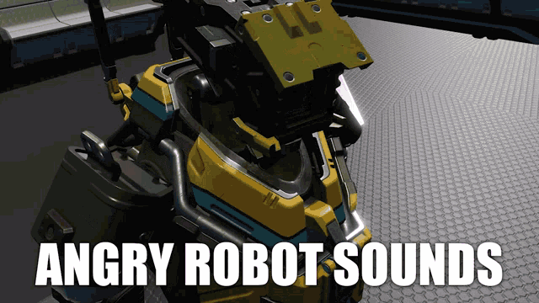
History of AI and ML
200+ years of work to be an overnight revolution

Slide 10
History of Artificial Intelligence and Machine Learning
Hopfield & Hinton just won the Nobel Prize for Physics
1769: ”The Turk”, a chess playing automaton beats Benjamin Franklin at chess
1989:Linnainmaa et al develop Backpropogation
1913: Andrey Markov analyses a poem; The techniques later become known as Markov chains.
1951: Minskey & Edmonds build the SNARC reinforcement learning machine
1989: Watkins introduces Q-Learning
1805: Adrien-Marie Legendre describes the Least Squares Method
1943: McCullough & Pitts model the first “Artificial Neuron”
1965: First Chatbot: ELIZA
1957: Rosenblatt invents the Perceptron
1995:Cortes and Vapnick invent Support Vector Machines
1983: Hinton invents Boltzmann Machines
1763: Thomas Bayes publishes "An Essay Towards Solving a Problem in the Doctrine of Chances” (aka Bayes Theorem)
1979: Fukushima invents ‘Neocognitron’, an early Convolutional Neural Network
1945: Shannon publishes early version of “A Mathematical Theory of Communication” (not declassified until ‘48)
1995: Ho invents Random Forests
1922: First use of the word ‘Robot’
1965: Stochastic Gradient Descent
1982: Hopfield invents Recurrent Neural Networks
1833: Charles Babbage’s “Difference Engine” (referred to as the ‘Thinking Machine”) calculates 6-digit polynomials
1951: Fix and Hodges invent k-Nearest Neighbor algorithm
1800s
1900s
1910s
1920s
1930s
1940s
1950s
1960s
1970s
1980s
1990s
UU
Established
IBM
Established
“Great Depression”
WWII
Microsoft Established
BBC
Established
WWI
First AI Winter:
Failure of Machine Translation / Perceptron's
Second AI Winter
Failure of Hardware Accelerated ML Market (Lisp Machines/ Connection Machines)

Slide 11
History of Artificial Intelligence and Machine Learning
Hopfield & Hinton just won the Nobel Prize for Physics
1989:Linnainmaa et al develop Backpropogation
2009: Stanford releases ImageNet
2015: Goodfellow invents Generative Adversarial Networks
Good luck keeping up
1997: Hochreiter & Schmidhuber invent long short-term memory (LSTM)
1989: Watkins introduces Q-Learning
2016: AlphaGo beats humans
2012: AlexNet paper published
2021:DALL.E launched
1997: DeepBlue beats Kasparov
2018:GPT-1 launched
1995:Cortes and Vapnick invent Support Vector Machines
2019:GPT-2 launched
2017:Google publishes first ‘Transformer’ Architecture
2020:GPT-3 launched
1983: Hinton invents Boltzmann Machines
2002: `torch` project started at EPFL
2013: word2vec paper published
2022:GPT-3.5 launched
2023:Bard launched
1998: LaCunn publishes MNIST database of handwriting samples
2023:GPT4 launched
1982: Hopfield invents Recurrent Neural Networks
2014:Bahdanau publishes Attention mechanism
2018:Google publishes first ‘BERT’ models
2024:GPT-o1 launched
1995: Ho invents Random Forests
1980s
1990s
1995
2000
2005
2010
2015
2020
‘Today’
NVIDIA Established
Google Established
“Global Financial Crisis”
Amazon Established
Facebook Established
Second AI Winter
Failure of Hardware Accelerated ML Market (Lisp Machines/ Connection Machines)
Netflix Established
OpenAI Established
Dot-Com Bubble Bursts
Third AI Winter
Buzzword saturation;

Slide 12
Biased Summary
Decade | Summary
Before… | Statistical methods are discovered and refined.
1950s | Pioneering machine learning research is conducted using simple algorithms.
1960s | Bayesian methods are introduced for probabilistic inference in machine learning.^{[1]}
1970s | ❄️'AI winter' when perceptrons fail to solve translation. ❄️
1980s | Rediscovery of backpropagation causes a resurgence in machine learning research. ❄️Second AI Winter when Neural-modelled (lisp) machines fail in market ❄️
1990s | Work on Machine learning shifts from a knowledge-driven approach to a data-driven approach. Support-vector machines (SVMs) and recurrent neural networks (RNNs) become popular.^{[3]}
2000s | Support-Vector Clustering^{[5]} and other kernel methods^{[6]} and unsupervised machine learning methods become widespread.^{[7]} ❄️Third AI Winter because of buzzword satiation❄️
2010s | Deep learning becomes feasible which spurs huge advances in vision and text processing.
2020s | Generative AI leads to revolutionary models, The commercial potential of AI based on machine learning causes large increases in valuations of companies linked to AI.

Slide 13
Take Aways
AI has always been everything that’s new/clever/next, until it’s mundane
Developments are ‘clumpy’ around advanced in hardware/theory
“AI Winters” happen

Slide 14

Simplest possible explanation I can muster on LLMs
Without Hallucinating…

Slide 15
Large Language Models…
“It’s not a Stochastic Parrot, he’s a very naughty boy”
The quick brown fox jumped over…
[1,0,1,0,-1]
[1,-1,0,1,0]
[0,1,-1,0,1]
[0,1,-1,1,0]
…
ATTENTION etc.
ATTENTION etc.
…
the lazy dog.
[1,0,1,0,-1]
[1,-1,0,1,0]
[0,1,-1,0,1]
[1,0,1,0,-1]
[1,0,1,0,-1]
[1,-1,0,1,0]
[0,1,-1,0,1]
[0,1,-1,1,0]
Take in text (prompt) from a user
Convert that text into numerical embeddings (tensors)
Use those tensors to feed an attention network the sequence of the prompt
And keep running the attention network after the end of the prompt,.
Outputting the ‘most likely’ future embeddings, as text

Slide 16
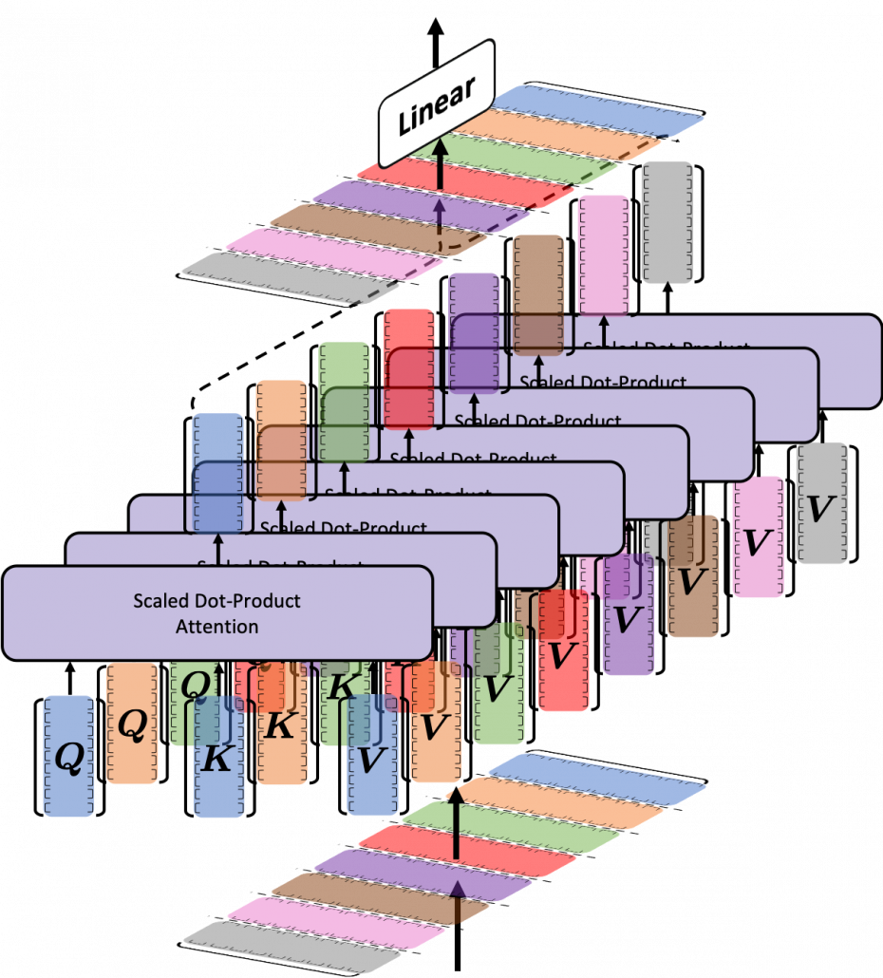
But it’s not quite that simple
“Most Likely” is doing a lot of work there
Each has a ‘weight’ dimension
Each +/- N Tokens
Each +/- Attention Head
Each +/- Head Layer
Training all these weights is why gpt-3 had 175 billion parameters

Slide 17

For more; Just go here
It’s the best, with real Jupyter notebooks to build it out.
Everything beyond that is data and human feedback.
https://jalammar.github.io/illustrated-transformer/

Slide 18
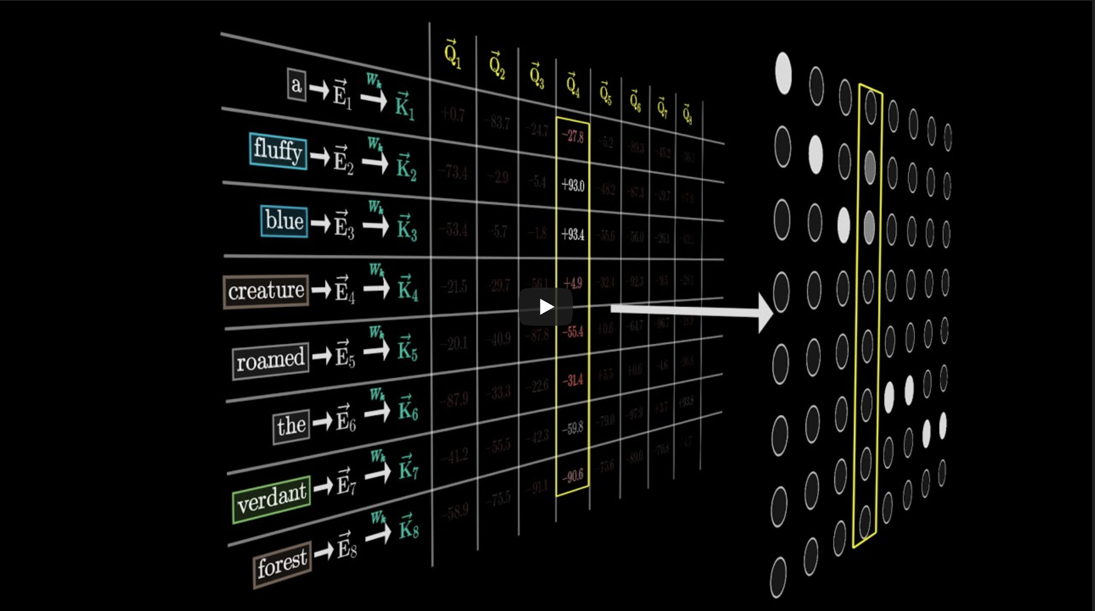
And for more pretty pictures,
Best visual explanation of
Embedding
Deep Networks
Attention Heads
Temperature
Also highly recommend trying out the manim package for your own visualisations
Hard to beat 3b1b https://www.3blue1brown.com/topics/neural-networks

Slide 19
How do LLM’s “Know” things?
I don’t think they drink…
Training
Repeatedly ‘showing’ a new LLM existing data, with [MASK]s, updating weights until they ‘work’
Fine Tuning
Repeatedly ‘showing’ an existing LLM new data, with [MASK]s, updating weights until they ‘work better’
Prompt Engineering
Asking the LLM ‘nicely’ in various ways to do the ‘work’ better based on its internal ‘training’
Retrieval Augmented Generation
Give the LLM a search engine of new data to populate the prompt/context with ‘real’ knowledge

Slide 20
How does RAG work?
See “Context All The Way Down”
LLMs are expensive to train
Expensive even to ‘fine tune’
RAG lets LLM have more ‘memory’ than token limit
Think about ‘prompt’ as ‘working memory’; RAG is ‘reliving’ a memory to bring it into ‘short term’ memory to answer a question
Retrieval Augmented Generation
Question?
LLM
Response?
Question + Context
LLM
Question?
RAG
Response
Data Store
Chunk 000
Top N
Chunk 420
Chunk 001
||E(Q)-E(C)||
Chunk 690
Context
Chunk 002
Chunk 007
Chunk XXX

Slide 21
What about….
Tool Use, Prompt Flow, Assistants, Chain-Of-Thought, ReRanking, Agentic Services, Hyper-Chunks, Distillation, Data Fabrics, Lakehouses, Graph-of-Thought?
Those are just tools and orchestrations,
just like every other software…
(Only one of these is fake, answer on bolster.bsky.social)

Slide 22
Take Aways
LLMs are big and complex, but simple; “what is the least surprising next token?”
“Common Knowledge” is baked into the training corpus, “Common Sense” isn’t
LLMs are Natural Language Interfaces to data, if you have RAG

Slide 23

Decision Support Systems
A helpful abstraction in a complex world

Slide 24
What are we actually trying to do with ‘Intelligent Systems’?
Automate Decisions
Decisions without context or confidence can’t build trust
Generate Content
‘Most Likely’ needs to be explainable to understand the suggestions within context
Summarize Content
Projecting semantic meaning from a question, through a data store, and back to a pithy response, requiring traceability and actionability if invalid

Slide 25
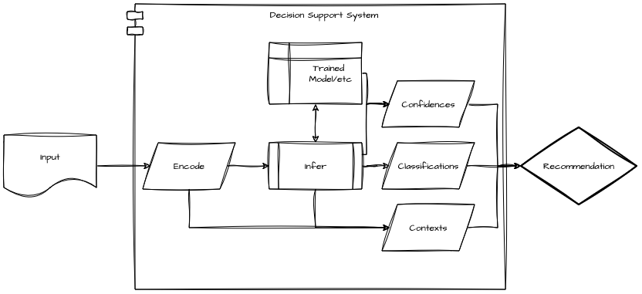
Decision Support System
Generic way to think about Intelligent Systems

Slide 26
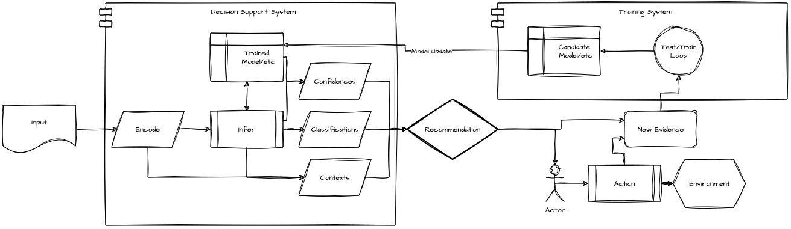
Decision Support System
Generic way to think about Intelligent Systems

Slide 27
Leveraging Data for AI
Scale human expertise via operational observation
“Actions” can be anything
Continuous feedback and probabilistic ‘Action’ mitigate data drift
Any interaction point can be an automation point with sufficient feedback
Context
Context
Suggestion
Context
Action
Action
Action
Interaction Point
Interaction Point
Automated Process Step
Train on Feedback
Monitor for Data Drift

Slide 28
Precursors for AI applications
Consistent Data*
Context + Action/Expected Outcome
Persistent Feedback*
Support multiple opinions
Risk-Acceptance
Transition from binary to confidence/risk based recommendations
Data
Recommendation
Decision
Impact
Feedback
ML
Risk
* MUST include N+1th order responses (aka Human Assessor/Client responses)

Slide 29
Take Aways
Intelligent Systems should support decision making
Identify Interaction Points for opportunities to improve systems
Any Intelligent System is only as good as the feedback you collect

Slide 30

What does it mean to be “Production Ready”
Sales, Support and Solicitors

Slide 31
Welcome to modern development
Most AI/Data scientists live in ‘code’ land.
Maybe ‘build’ and ‘plan’ land if they have an SWE or PM background.
But, the code works, so you’re done, right?
You are here

Slide 32
“Production Ready”
Budget and Pricing?
Dev/Staging Environments?
Packaging?
Version Control?
Customer Notices?
Dependencies?
Sales/ Marketing?
Compilation?
Customer Support?
On-Call Support?
Quality Standards?
Integrations and 3rd party?
Unit Tests?
Metrics, Observability and Alerts?
Integration Tests?
Versioning / Changelogs?
Documentation / Runbooks?
Customer Feedback?

Slide 33
“Production Ready”
Budget and Pricing?
Software Engineering
Dev/Staging Environments?
Packaging?
Sales /
Product Management
Version Control?
Customer Notices?
Dependencies?
Sales/ Marketing?
Compilation?
Customer Support?
On-Call Support?
Customer
Success
Quality Standards?
Integrations and 3rd party?
Unit Tests?
Metrics, Observability and Alerts?
Integration Tests?
Versioning / Changelogs?
Quality Assurance
Cloud Operations
Documentation / Runbooks?
Customer Feedback?
Technical /
Copy Writing

Slide 34
Why do we need all this?
Cost:
Compute is expensive,
Code is more expensive,
Broken code is most expensive
Testing is ‘cheap’
Stability:
Customers don’t like systems they cannot trust
Customers pay lawyers to sue products that break that trust
Repeatability:
Novelty is the engine of “innovation”
Patterns are the engine of “success”

Slide 35
Take Aways
The distance between “Works on my machine” and an actual product is a lot further away than you think.
What is a “cool experiment” to you is a potential reputational / legal risk to the enterprise
R&D is easy; integration is hard; make friends and collaborate early

Slide 36

Building Systems, not Features, for Production
Go far, together

Slide 37

What do you need to run an intelligent service?
“AI” appears to be magical, until they’re not
Quality/“Skill issues”, unreliability, inconsistent customer journey
Difficulty in establishing IP/Biz USP/growing value
“Tony Stark was able to build this in a cave! With a bunch of scraps!”
PoC’s are easy, ‘works on my machine’, ‘just push it to prod’
Ok, build 2,000 of them a day and sell it to customers with legal teams

Slide 38
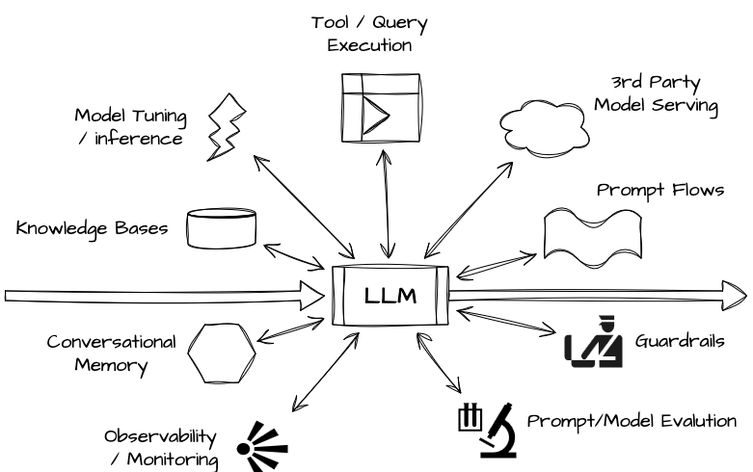
What do you need to run an intelligent service?
Production grade intelligent services require significant investment and maturity to reliably provide value
“Check box exercises” and “gimmicks” will reduce trust.
It’s not as simple as you think

Slide 39
Nice idea, right?
How does it really work?
I know it’s not LLM specific but trust me, this is simpler

Slide 40


Slide 41
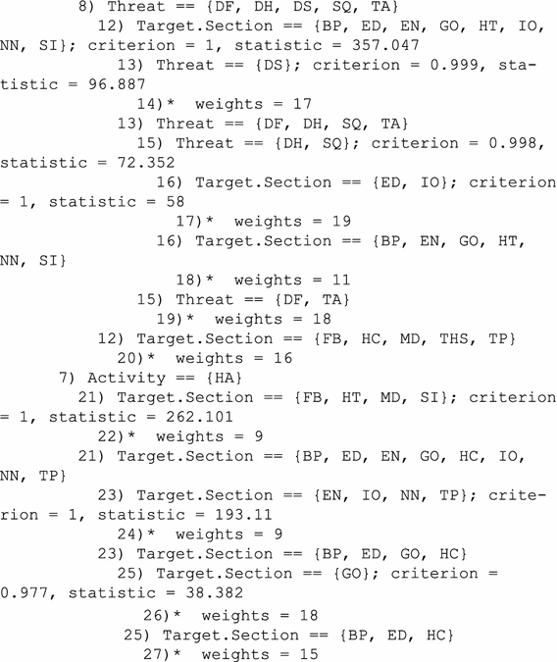


Slide 42
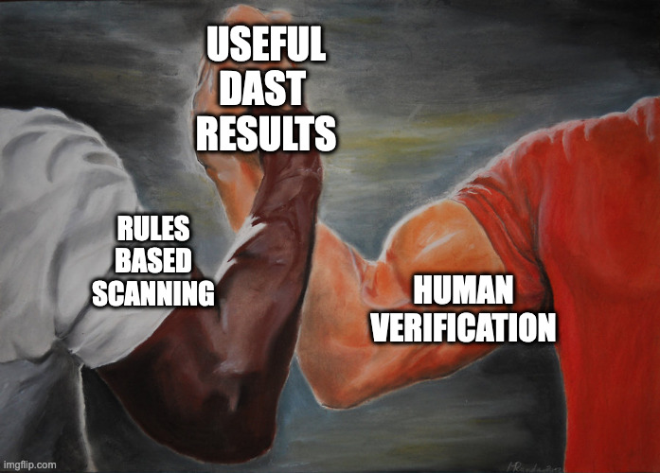

Slide 43
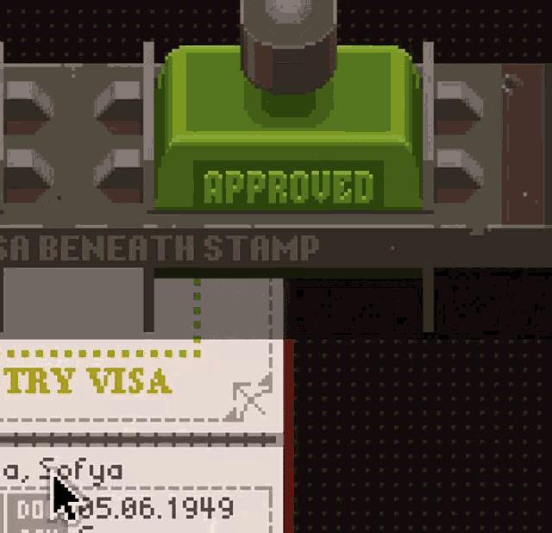

Slide 44

{
"endpoint":"https://www.example.com",
"scopes":[
"www.example.com",
"assets.example.com"
]
}

Slide 45


GET www.example.com
<html>
<a href=‘/page1.html’>Link</a>
</html>
GET www.example.com/page1.html
[
"https://www.example.com/index.html",
"https://www.example.com/page1.html",
"https://www.example.com/contact_us.html",
"https://www.example.com/sales.html"
]

Slide 46
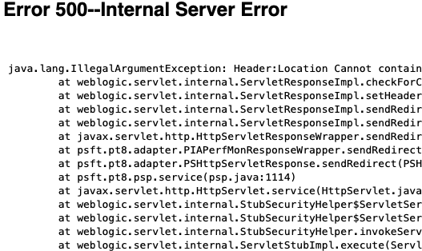
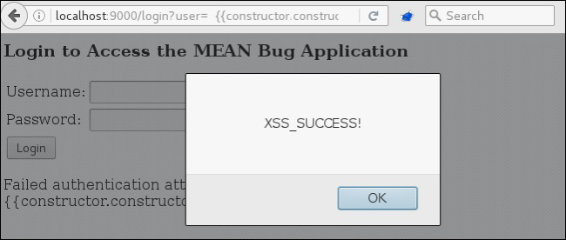

Slide 47

Dear Human, When I was interrogating www.example.com, I found this thing.
What do you think?
Love
Regex9827465296

Slide 48


Slide 49
Top 10 DAST Findings

Slide 50

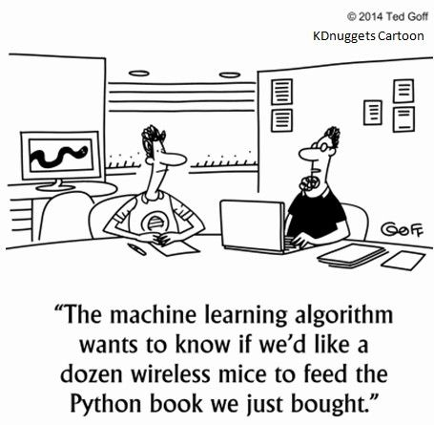

Slide 51


Slide 52
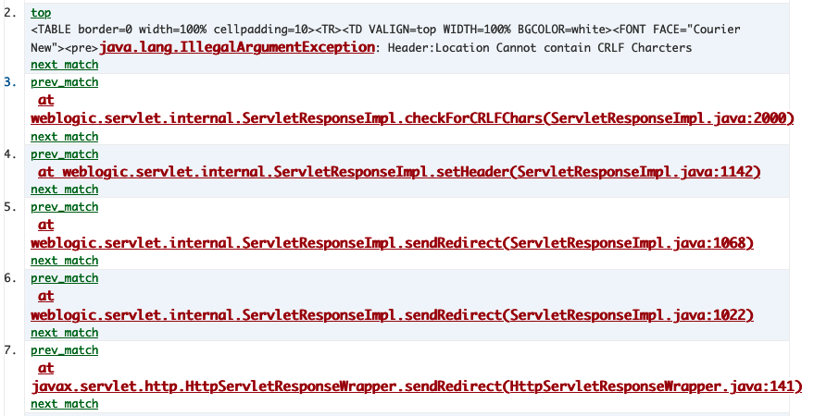
Information Leakage
“Verify that the application does not output error messages or stack traces containing sensitive data that could assist an attacker, including session id, software/framework versions and personal information"
What the scanner ‘sees’
What the ML reads
Note this model is a TextCNN Conv 2048 chars, 100 channels

Slide 53









Slide 54

Target
Scanner
Evidence
Assessor
“Real” Votes
RNG <0.95
Y
N
“Shadow”

Slide 55
It worked!
If DSS isn’t confident, don’t change the environment
Sometimes, even if confident, let the human decide
Let action owners decide how confident is ‘enough’
Interaction Point
Decision Support System
Feedback
Winning

Slide 56
High Level Intelligent Ecosystem Capabilities
People
R&D/Data [Science/Engineering] & relationships with Product / SWE teams
Data Management
Data Stores, Governance, and Access
Generic Model Creation
Data Exploration and experimental compute
Model Deployment & Release
Inference serving/monitoring
LLM Ops
Model discovery and prompt management
Application Integration
Ability to bring novel capabilities to existing products with confidence

Slide 57
MLOps/LLMOps Maturity Model – Eye test version
Capabilities | Initial | Minimal | Procedural | Innovative | Leading
People | Data scientists: siloed, not in regular communications with the larger team Data engineers (if exists): siloed, not in regular communications with the larger team Software engineers: siloed, receive model remotely from the other team members | Data scientists: siloed, not in regular communications with the larger team Data engineers (if exists): siloed, not in regular communication with the larger team Software engineers: siloed, receive model remotely from the other team members | Data scientists: Working directly with data engineers to convert experimentation code into repeatable scripts/jobs Data engineers: Working with data scientists Software engineers: siloed, receive model remotely from the other team members | Data scientists: Working directly with data engineers to convert experimentation code into repeatable scripts/jobs Data engineers: Working with data scientists and software engineers to manage inputs/outputs Software engineers: Working with data engineers to automate model integration into application code | Data scientists: Working directly with data engineers to convert experimentation code into repeatable scripts/jobs. Working with software engineers to identify markers for data engineers Data engineers: Working with data scientists and software engineers to manage inputs/outputs Software engineers: Working with data engineers to automate model integration into application code. Implementing post-deployment metrics gathering
Data Management and Exploration | Disparate data sources with unaligned identifiers/taxonomies No shared non-product data store Data sensitivity un/underspecified Individual/Local based case-by-case and dataset-by-dataset data access ETL style tasks largely script-driven | Disparate data sources with unaligned identifiers/taxonomies Shared experimental / dev unstructured data store (with no ACL) Data sensitivity specified but unenforced Individual/Local based case-by-case and dataset-by-dataset data access ETL style tasks driven by version controlled transformations | Disparate data sources with common external identifiers mappings / shared taxonomies Common downstream unstructured data store with basic dataset/user level ACL Data sensitivity enforced at the dataset level, specified but unenforced at the attribute level, with informal rules around aggregate sensitivity ETL style tasks driven by version controlled & release managed transformations, with replica staging deployments for testing | Aligned / Shared data sources with common entity identifiers and unified taxonomies Common downstream unstructured and analytical datastores with transparent row-level ACL Data sensitivity enforced at the row level, specified but unenforced at the attribute level, formal rules around aggregate sensitivity ETL style tasks driven by version controlled & release managed transformations, with replica staging deployments for testing | Aligned / Shared data sources with common entity identifiers and unified taxonomies Common downstream unstructured and analytical datastores with transparent attribute-level ACL Data sensitivity enforced at the attribute level, specified but unenforced at the attribute level ETL style tasks driven by CI/CD transformations, with replica staging deployments for testing
Generic Model Creation | Data gathered manually Compute is likely not managed Experiments aren't predictably tracked End result might be a single model file manually handed off with inputs/outputs | Data pipeline gathers data automatically Compute is or isn't managed Experiments aren't predictably tracked End result might be a single model file manually handed off with inputs/outputs | Data pipeline gathers data automatically Compute managed Experiment results tracked Both training code and resulting models are version controlled | Data pipeline gathers data automatically Compute managed Experiment results tracked Both training code and resulting models are version controlled | Data pipeline gathers data automatically Retraining triggered automatically based on production metrics Compute managed Experiment results tracked Both training code and resulting models are version controlled
Generic Model Deployment and Release | Manual process Scoring script might be manually created well after experiments, not version controlled Release handled by data scientist or data engineer alone | Manual process Scoring script might be manually created well after experiments, likely version controlled Is handed off to software engineers | Manual release Scoring script is version controlled with tests Release managed by Software engineering team | Automatic release Scoring script is version controlled with tests Release managed by continuous delivery (CI/CD) pipeline | Automatic Release Scoring Script is version controlled with tests Release managed by continuous integration and CI/CD pipeline
Large Language Model Ops | Organic discovery of models and testing prompts Basic Lab-driven Feedback Evaluation and Monitoring | Shared model / inference resources Iterative model augmentation with prompt engineering and RAG Structured Deployment and prompt-based feedback evaluations | Centralized model/inference resources Versioned prompt management and release-driven deployment Structured deployment and inference based feedback driven evaluations | Model serving/inference ‘as a service’ with resources under IaC Comprehensive prompt management and real-time deployment Advanced monitoring and automated alerts | Seamless, collaborative environment for CI/CD Fully automated monitoring and model/prompt refinement
Application Integration and Maintenance | Heavily reliant on data scientist expertise to implement Manual releases each time | Basic integration tests exist for the model Heavily reliant on data scientist expertise to implement model Releases automated Application code has unit tests | Basic integration tests exist for the model Heavily reliant on data scientist expertise to implement model Application code has unit tests | Unit and integration tests for each model release Less reliant on data scientist expertise to implement model Application code has unit/integration tests | Unit and Integration tests for each model release Less reliant on data scientist expertise to implement model Application code has unit/integration tests

Slide 58
So what’s your advice?
Identify Interaction Points
Suggest
Measure Acceptance
Retrain
Collect Context/Action data
Make friends with Operations / Compliance
Make Predictions, and Measure
Be ‘better than a coinflip’

Slide 59
Conclusions / What-To-Take-Away
Buzzwords
“AI” has a history of being a term for ‘any technology we don’t use regularly yet’
Interaction Points
“Give me a fulcrum and I’ll automate the world”
Hallucinations
“LLMs” don’t “lie”; they blabber without regard for the truth
Production
The distance between “Works on my machine” and an actual product is a lot further away than you think.
Systems
To cross that distance, you need to bring a clan along with you.

Slide 60
Follow us on LinkedIn for roles/placements in Belfast
Follow me on LinkedIn/BSky for the craic

